Slide 1
L05.01 Hashing
50.004 Introduction to Algorithm
Dr. Simon LUI
ISTD, SUTD

Slide 2
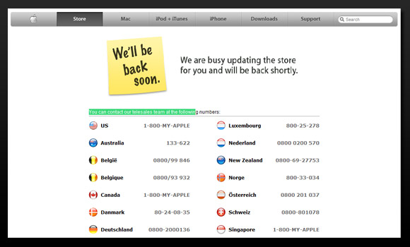

Introduction
Remember we mentioned in Lecture 1
Simon want to be the world first person to buy the new iPhone
Keep on reloading apple.com (keep pressing F5)
Looking for this moment:
Any better way?

Slide 3
Introduction
And this is my solution: use Hash function
MD5 Hash function
MD5 Hash function
yquwildksruagshj
15qtaysusfnmg8gi

Slide 4
Introduction
The MD5 hash function can convert any data (of any length) into a 16 byte value
Data of any length
e.g. www.apple.com/iPhone.html
<HTML><HEAD></HEAD><BODY>weWECWEEWCWECWEF3TERGERVIHROIFVHWVOJHWRVOIHd;oi239r08y2e3foihwef;opewf;lkwefoihwefoiwcl;sC2POIF</BODY></HTML>
16 BYTE DATA
e.g.
hsjdkiwo27urjgn7
MD5 Hash
- I have a server program, which check the MD5 value of the page every 0.5 second.
- When the 16 byte MD5 value changed, then, it is VERY POSSIBLE that there are some BIG change on the page!

Slide 5
Hash: map data of arbitrary size to data of fixed size
Now, the formal maths and definition

Slide 6
Goal
Given n distinct keys from the set U
e.g., n=100, U={0,1,…,9999}
Propose an Abstract Data Type (ADT) where:
add(k), delete(k) = O(1)
search(k) = O(1) on the average
Example of implementation
Python dictionaries: item = (key, value)
d = ‘morning’: 51, ‘best’: 8
d.items() -> [(‘morning’,51), (‘best’,8)]
‘best’ in d -> True
1 in d -> False

Slide 7
Example of usage
Built into most modern programming languages (Python, Perl, Java, C++,…)
Example:
English dictionary for spelling corrections, definitions
Compilers: symbol tables (list of names and related info)
Network routers: port number -> socket id
virtual memory: virtual address -> physical address

Slide 8
Example of hash (small table with collision)
Input source: N=10 (10 numbers in the circle)
Input: n=4 (we select 4 numbers from N for mapping)
Output: m=9 (9 slots in A[]) <10
h() is the hash function
It will map 0,3,5,9 to A[0], A[3], A[5], A[0] respectively
A[0]
0,9
Collision at A[0]
A[1]
nil
U
4
6
n
…
nil
1
5
3
8
0
3
9
nil
2
5
7
nil
nil
Hash table A[0..8]
size m=9
A[8]
nil

Slide 9
Handling collisions
Use a linked list to store the keys that collide
A[0]
0
9
U
4
6
A[1]
n
nil
1
nil
5
…
8
0
3
9
3
2
nil
7
5
nil
nil
A[8]
nil

Slide 10
Example of a better hash function
The mid-square method
It squares the key value, then takes out the middle r bits of the result, giving a value in the range 0 to base^{r}-1.
Example:
r = 2
base^{r}-1 = 99. (so output range is 0 to 99)
4567
x 4567
20857489
So hash table size m = 100
h(4567) = 57

Slide 11
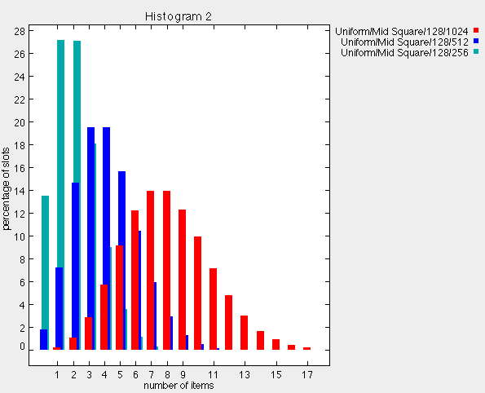
Statistics from experiments
http://research.cs.vt.edu/AVresearch/hashing/midsquare.php
k x k
7 bits
100101001101010110101100101
Hash table size
m =2⁷= 128
(base = 2)

Slide 12
Lets summarize!
Hash functions h()
h maps the large universe of keys U to entries of the
hash table T (a much smaller set)
Problem: possible collisions

Slide 13
Resolving collisions: chaining
worse case
for given h()
= Θ(n)
insert(k) -> O(1)
delete(k) -> O(1)
search(k) -> Θ(n)

Slide 14
Worse case discussion
Assume |U|=N, hash table size = m, N > m
Lemma: Then for any hash function h there exist at least N/m keys that hash on the same position (collide)
distribution of N keys
for the given hash function h()
perfectly uniform
distribution of N keys
over the m slots
if there is a location i with < N/m keys
then there must be some other
location j with > N/m keys
there is some location
where ≥ N/m keys hash
N/m
N keys
0
j
i
m-1
For any hash function we can find ≥ N/m keys that collide

Slide 15
Average analysis
Under the simple uniform hashing assumption
n keys
like n balls being
thrown randomly
into m buckets
U
h
…
1/m
0
m-1
k1
average length
= n/m = α = “loading factor”
k2
search(k): O(n/m) = O(α)
if α = O(1) then search(k) = O(1)
k3
Notes:
Use deterministic paradigm

Slide 16
Probability calculations
We hash (uniformly) n items in m slots
…
…
0
1
i
m-1
…
…
0
1
i
m-1
y_{i} = 1 if slot i is empty after n trial

Slide 17
Universal hashing
“Hashing game”: for any hash function we use, an adversary
likes to choose the n keys (see previous lemma) to hash to the same
location in the table
Solution: Randomize the h()!
Pick h() at random from a very large set H
Definition: H is universal if for any pair of distinct keys k and r,
the number of h() s.t. the chance of h(k)=h(r) is at most |H|/m
- In simple words, for a randomly picked h(), Prob{h(k) = h(r)} ≤ 1/m
Theorem: Using universal hash functions, search(k₀) is O(α)

Slide 18
Hash functions for non-number input
Assumption: set of keys = set of natural numbers
If key not a natural number we find a way to transform it
Example: character string -> integer expressed in radix notation
What makes a “good” hash function?
simple uniform hashing assumption (UHA)
closely related symbols hash to different locations (x1, xx1,…)
ASCII character set:
7 bit representation -> radix = 128, 8 bit representation -> radix = 256

Slide 19
The division method
Choice of m: powers of 2 are bad. Since h(k) will just be the least significant p bits of l
So a good choice of m: A prime not close to 2^{p} for any integer p
Example:
m = 20
k = 91
h(k) = 11

Slide 20
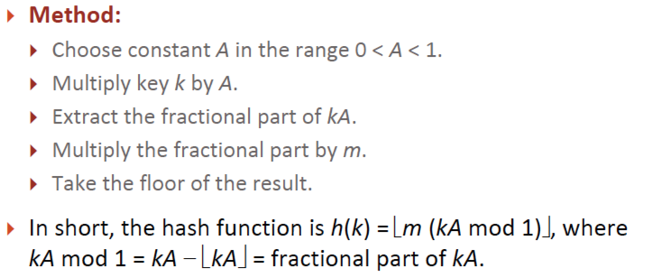
The multiplication method
Advantage: value of m is not critical (can be 2^{p})
Disadvantage: slower than division method

Slide 21
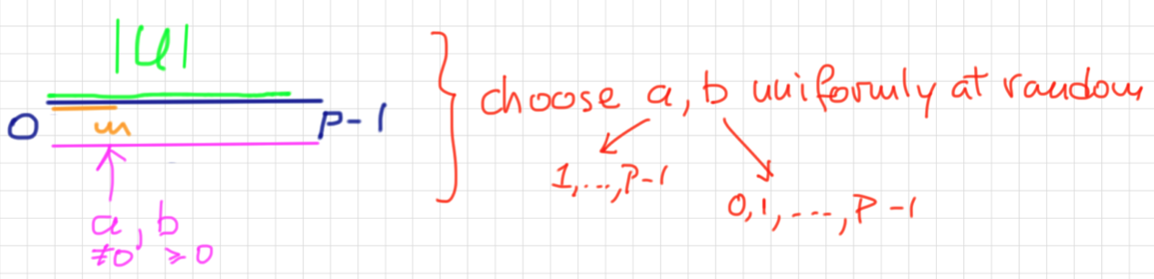
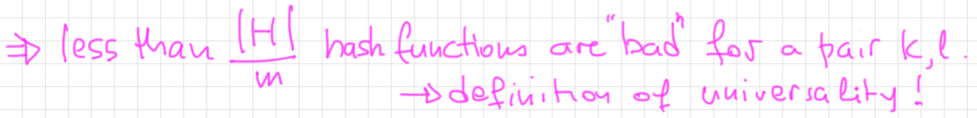
Universal hash functions
m = size of hash table = arbitrary
random choice of a, b for each experiment

Slide 22
Conclusions
Hashing is an efficient way to keep average cost of operations to O(1)
Collisions are unavoidable in practice and are solved by chaining
Worse case Θ(n)
We have some simple ways to construct “good” hash functions

